Slide 1
DeepLab : Semantic Image Segmentation with Deep Convolutional Nets, Atrous Convolution, and Fully Connected CRFs
COMPUTER VISION LAB
22211226 Ju-Hyeon Nam

Slide 2
Contents
Introduction
Methods
Experiment Results
Implementations

Slide 3
Contents
Introduction
Methods
Experiment Results
Implementations

Slide 4
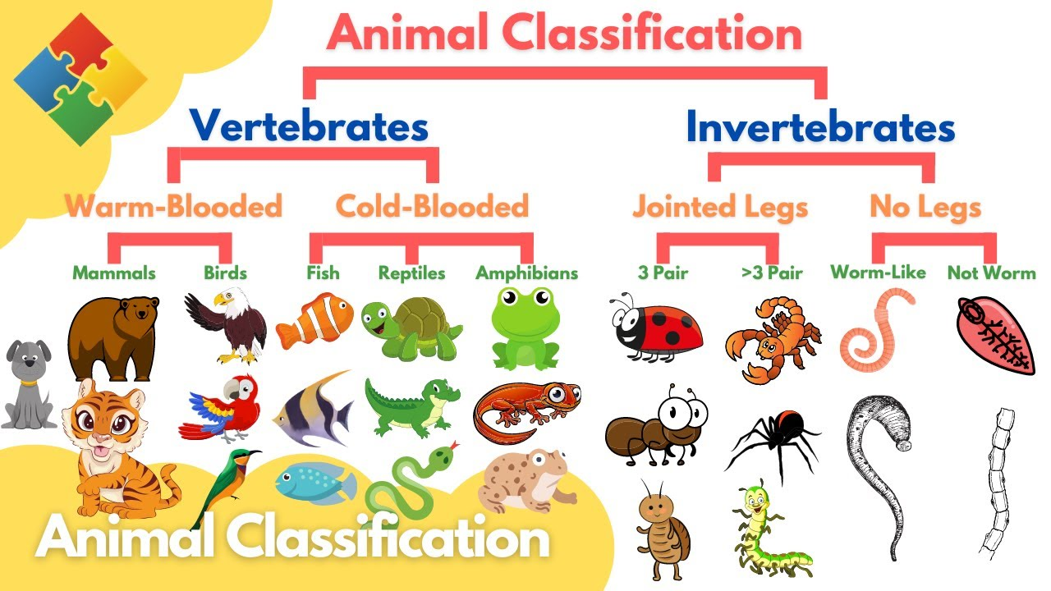
Introduction
Applications of Deep Convolutional Neural Networks
Image Classification

Slide 5
Introduction
Applications of Deep Convolutional Neural Networks
Image Classification
A. Krizhevsky, I. Sutskever, and G. E. Hinton, “Imagenet classification with deep convolutional neural networks,” in NIPS, 2013.
P. Sermanet, D. Eigen, X. Zhang, M. Mathieu, R. Fergus, and Y. LeCun, “Overfeat: Integrated recognition, localization and detection using convolutional networks,” arXiv:1312.6229, 2013.
K. Simonyan and A. Zisserman, “Very deep convolutional networks for large-scale image recognition,” in ICLR, 2015.
C. Szegedy, W. Liu, Y. Jia, P. Sermanet, S. Reed, D. Anguelov, D. Erhan, V. Vanhoucke, and A. Rabinovich, “Going deeper with convolutions,” arXiv:1409.4842, 2014.
G. Papandreou, I. Kokkinos, and P.-A. Savalle, “Modeling local and global deformations in deep learning: Epitomic convolution, multiple instance learning, and sliding window detection,” in CVPR, 2015.

Slide 6
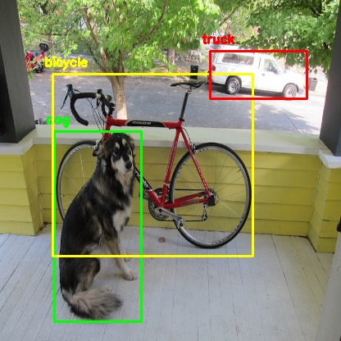
Introduction
Applications of Deep Convolutional Neural Networks
Object Detection

Slide 7
Introduction
Applications of Deep Convolutional Neural Networks
Object Detection
R. Girshick, J. Donahue, T. Darrell, and J. Malik, “Rich feature hierarchies for accurate object detection and semantic segmentation,” in CVPR, 2014.
D. Erhan, C. Szegedy, A. Toshev, and D. Anguelov, “Scalable object detection using deep neural networks,” in CVPR, 2014.
R. Girshick, “Fast r-cnn,” in ICCV, 2015.
S. Ren, K. He, R. Girshick, and J. Sun, “Faster r-cnn: Towards realtime object detection with region proposal networks,” in NIPS, 2015.
K. He, X. Zhang, S. Ren, and J. Sun, “Deep residual learning for image recognition,” arXiv:1512.03385, 2015.
W. Liu, D. Anguelov, D. Erhan, C. Szegedy, and S. Reed, “SSD: Single shot multibox detector,” arXiv:1512.02325, 2015.

Slide 8
Introduction
Applications of Deep Convolutional Neural Networks
Characteristic Architecture in Image Classification and Object Detection
Invariance of DCNN to local image transformations
Abstract data representation!!
Hamper dense prediction task(Segmentation)

Slide 9
Introduction
Challenge in Semantic Image Segmentation
1. Reduced Feature Resolution
2. Existence of object at multiple scales
3. Reduced localization accuracy due to DCNN invariance

Slide 10
Introduction
Challenge in Semantic Image Segmentation
1. Reduced Feature Resolution
CAUSE : The repeated combination of max-pooling and downsampling performed at consecutive layers of DCNNs
A. Krizhevsky, I. Sutskever, and G. E. Hinton, “Imagenet classification with deep convolutional neural networks,” in NIPS, 2013.
K. Simonyan and A. Zisserman, “Very deep convolutional networks for large-scale image recognition,” in ICLR, 2015.
C. Szegedy, W. Liu, Y. Jia, P. Sermanet, S. Reed, D. Anguelov, D. Erhan, V. Vanhoucke, and A. Rabinovich, “Going deeper with convolutions,” arXiv:1409.4842, 2014.
Solution
Remove the downsampling operator from the last few max pooling layers of DCNNs
Upsample the filters in subsequent convolutional layer
Atrous Convolution
Image Classification Architecture

Slide 11
Introduction
Challenge in Semantic Image Segmentation
2. Existence of object at multiple scales
Standard Solution
Present to the DCNN rescaled version of the same image
Aggregate the feature or score maps
G. Papandreou, I. Kokkinos, and P.-A. Savalle, “Modeling local and global deformations in deep learning: Epitomic convolution, multiple instance learning, and sliding window detection,” in CVPR, 2015.
L.-C. Chen, Y. Yang, J. Wang, W. Xu, and A. L. Yuille, “Attention to scale: Scale-aware semantic image segmentation,” in CVPR, 2016.
I. Kokkinos, “Pushing the boundaries of boundary detection using deep learning,” in ICLR, 2016
Solution
Spatial Pyramid Pooling(SPP)
S. Lazebnik, C. Schmid, and J. Ponce, “Beyond bags of features: Spatial pyramid matching for recognizing natural scene categories,” in CVPR, 2006.
K. He, X. Zhang, S. Ren, and J. Sun, “Spatial pyramid pooling in deep convolutional networks for visual recognition,” in ECCV, 2014.
Atrous Convolution + SPP = ASPP

Slide 12
Introduction
Challenge in Semantic Image Segmentation
3. Reduced localization accuracy due to DCNN invariance
CAUSE : An object centric classifier requires invariance to spatial transformations
Solution
Fully Connected Conditional Random Field(CRF)

Slide 13
Contents
Introduction
Methods
Experiment Results
Implementations

Slide 14
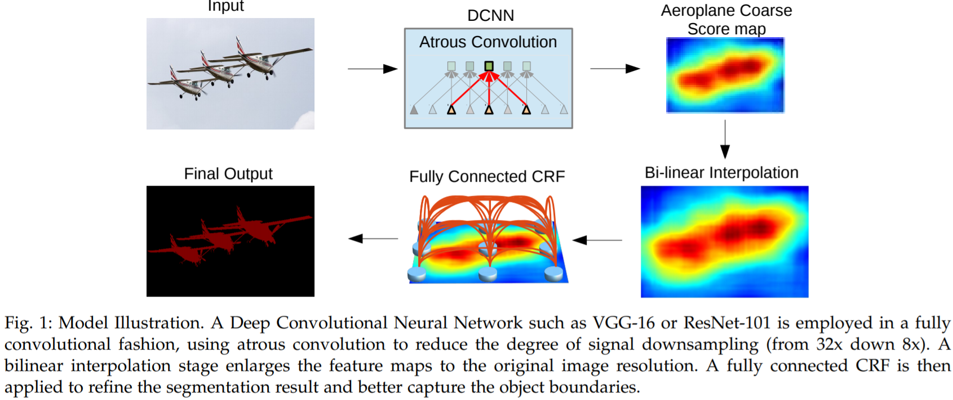
Methods
Overall Algorithm

Slide 15
Methods
Overall Algorithm
1. Transforming all the fully connected layers to convolutional layers
2. Increasing feature resolution through atrous convolutional layers

Slide 16
Methods
Overall Algorithm
Apply Bilinear interpolation

Slide 17
Methods
Overall Algorithm
Apply Fully Connected CRF

Slide 18
Methods
Contribution
Speed
Accuracy
Simplicity

Slide 19
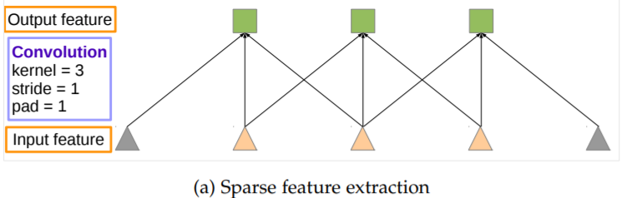
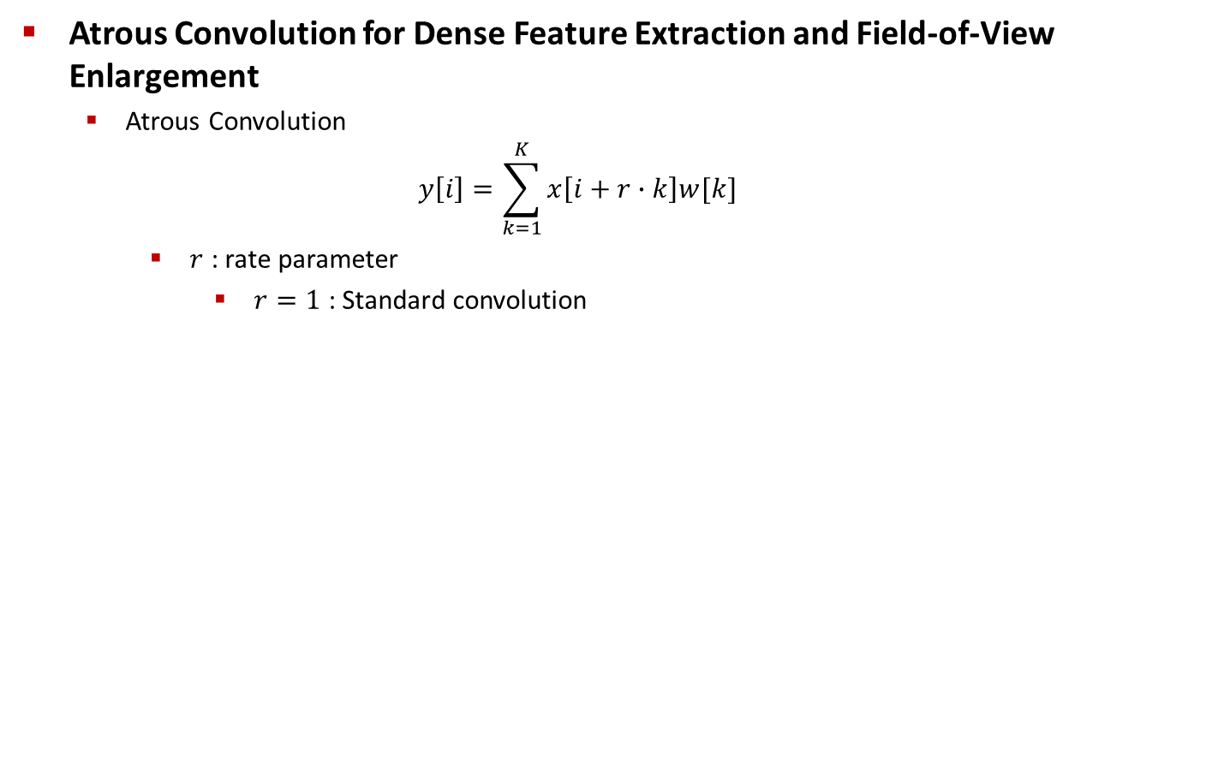
Methods
Atrous Convolution for Dense Feature Extraction and Field-of-View Enlargement
Atrous Convolution
$$y\left[i\right]=\sum_{k=1}^{K}{x\left[i+r∙k\right]w[k]}$$
$r$ : rate parameter
$r=1$ : Standard convolution

Slide 20
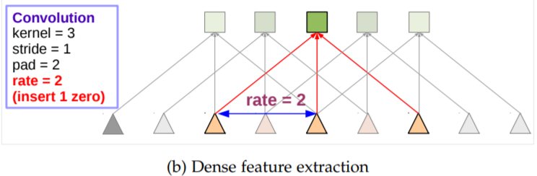
Methods
Atrous Convolution for Dense Feature Extraction and Field-of-View Enlargement
Atrous Convolution
$$y\left[i\right]=\sum_{k=1}^{K}{x\left[i+r∙k\right]w[k]}$$
$r$ : rate parameter
$r=1$ : Standard convolution

Slide 21


Methods
Atrous Convolution for Dense Feature Extraction and Field-of-View Enlargement
Atrous Convolution

Slide 22
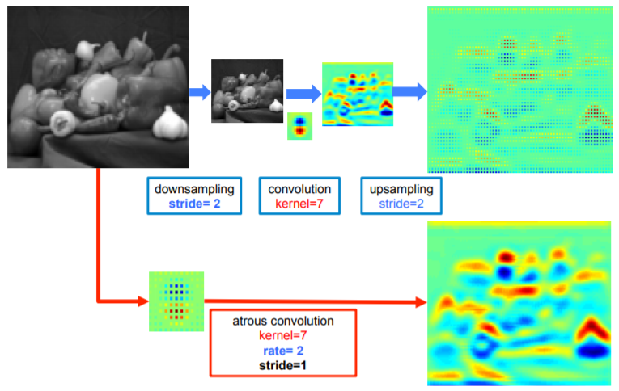
Methods
Atrous Convolution for Dense Feature Extraction and Field-of-View Enlargement
Upsample vs Atrous Convolution

Slide 23
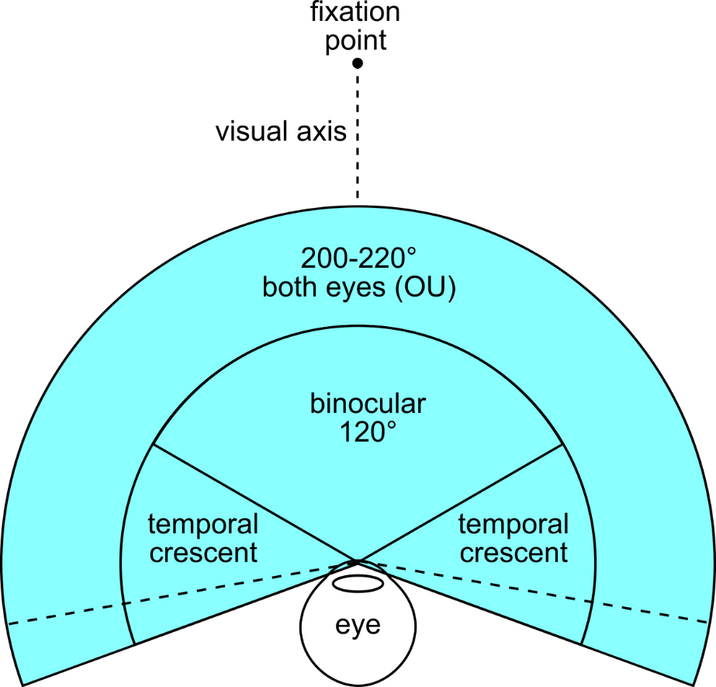
Methods
Atrous Convolution for Dense Feature Extraction and Field-of-View Enlargement
Effect of Atrous Convolution
1. Filter size ↑ ⇒ maintain non-zero filter values ⇒ maintain #operation & parameters
2. Field-of-View ↑

Slide 24
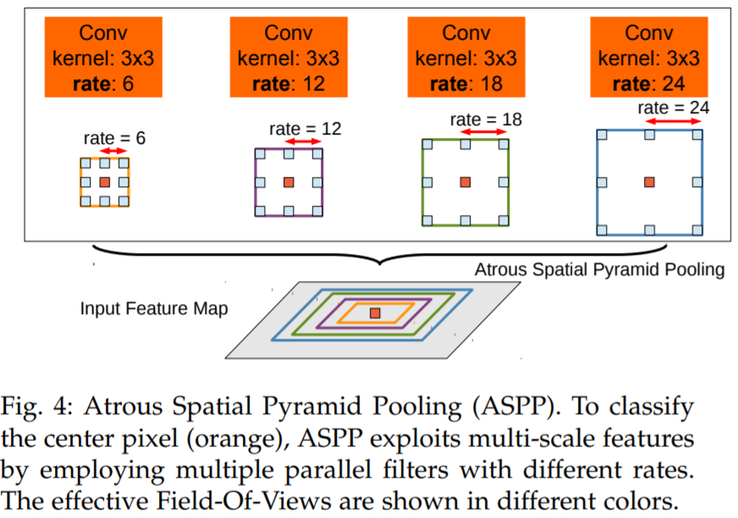
Methods
Multiscale Image Representation using Atrous Spatial Pyramid Pooling

Slide 25
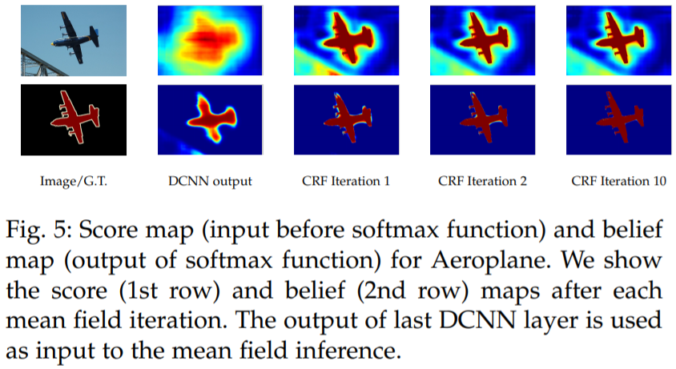
Methods
Structured Prediction with Fully-Connected Conditional Random Fields for Accurate Boundary Recovery

Slide 26
Contents
Introduction
Methods
Experiment Results
Implementations

Slide 27
Experiment Results
Experiment Settings
Feature Extractor
Model : ImageNet-Pretrained VGG-16 or ResNet-101
Fully-Connected Layer : 1000 Class ⇒ 21 Class(PASCAL VOC 2012)
Loss function
Sum of cross-entropy terms for each spatial position in the CNN output map
All Positions and labels are equally weighted in the overall loss function
Objective function
Stochastic Gradient Descent
Evaluation Procedure
STEP1. Train DCNN
STEP2. Inference
STEP3. Apply Fully-Connected CRF
Dataset
PASCAL VOC 2012 Segmentation benchmark
PASCAL-Context

Slide 28
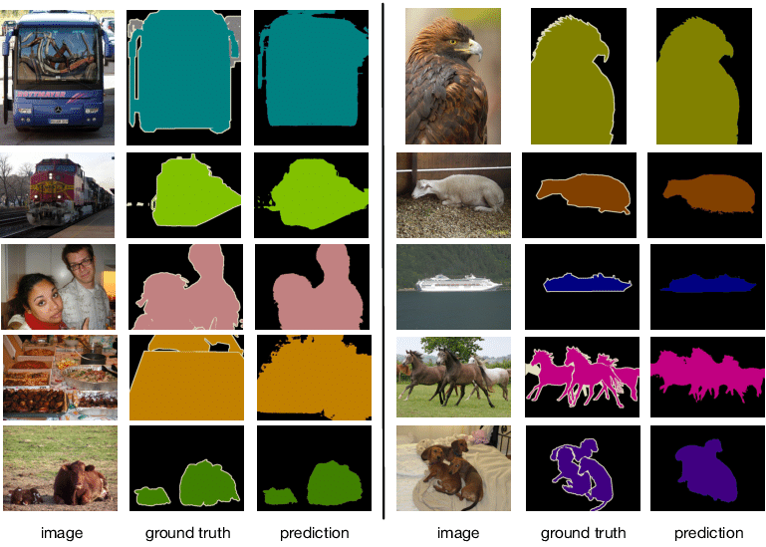
Experiment Results
Experiment Settings
Dataset
PASCAL VOC 2012 Segmentation benchmark

Slide 29
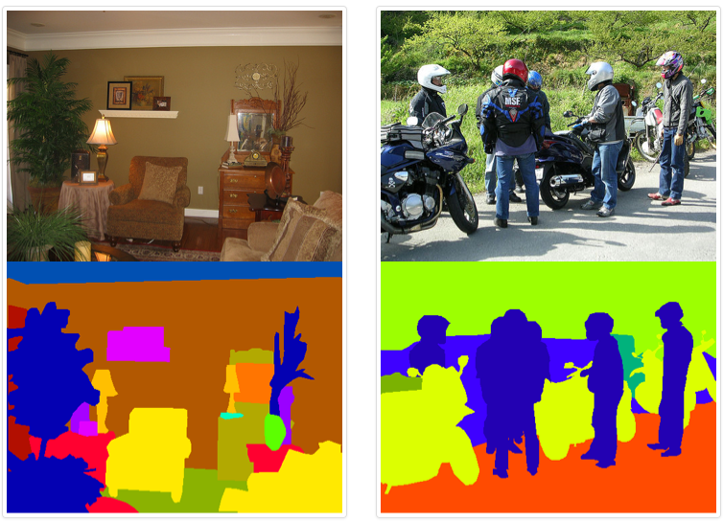
Experiment Results
Experiment Settings
Dataset
PASCAL-Context

Slide 30
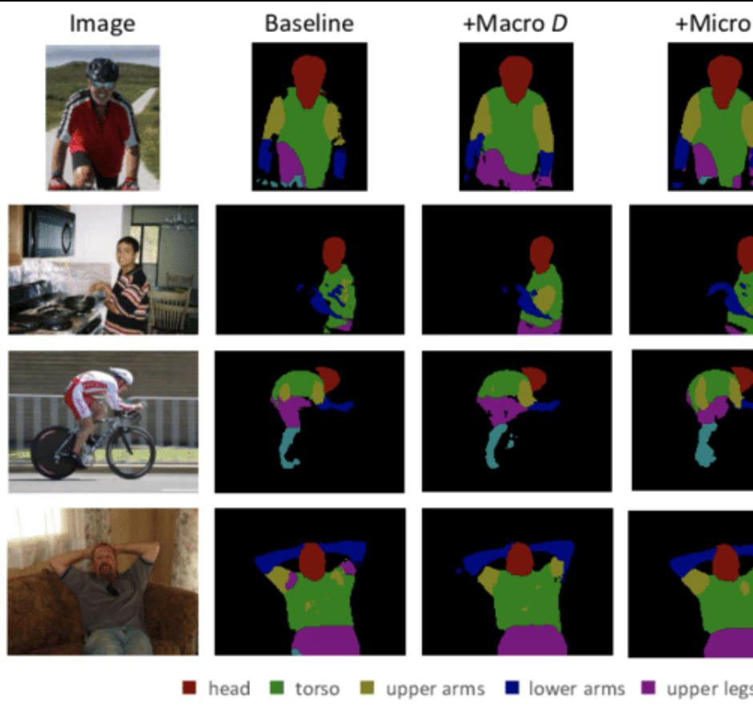
Experiment Results
Experiment Settings
Dataset
PASCAL-Person-Part

Slide 31
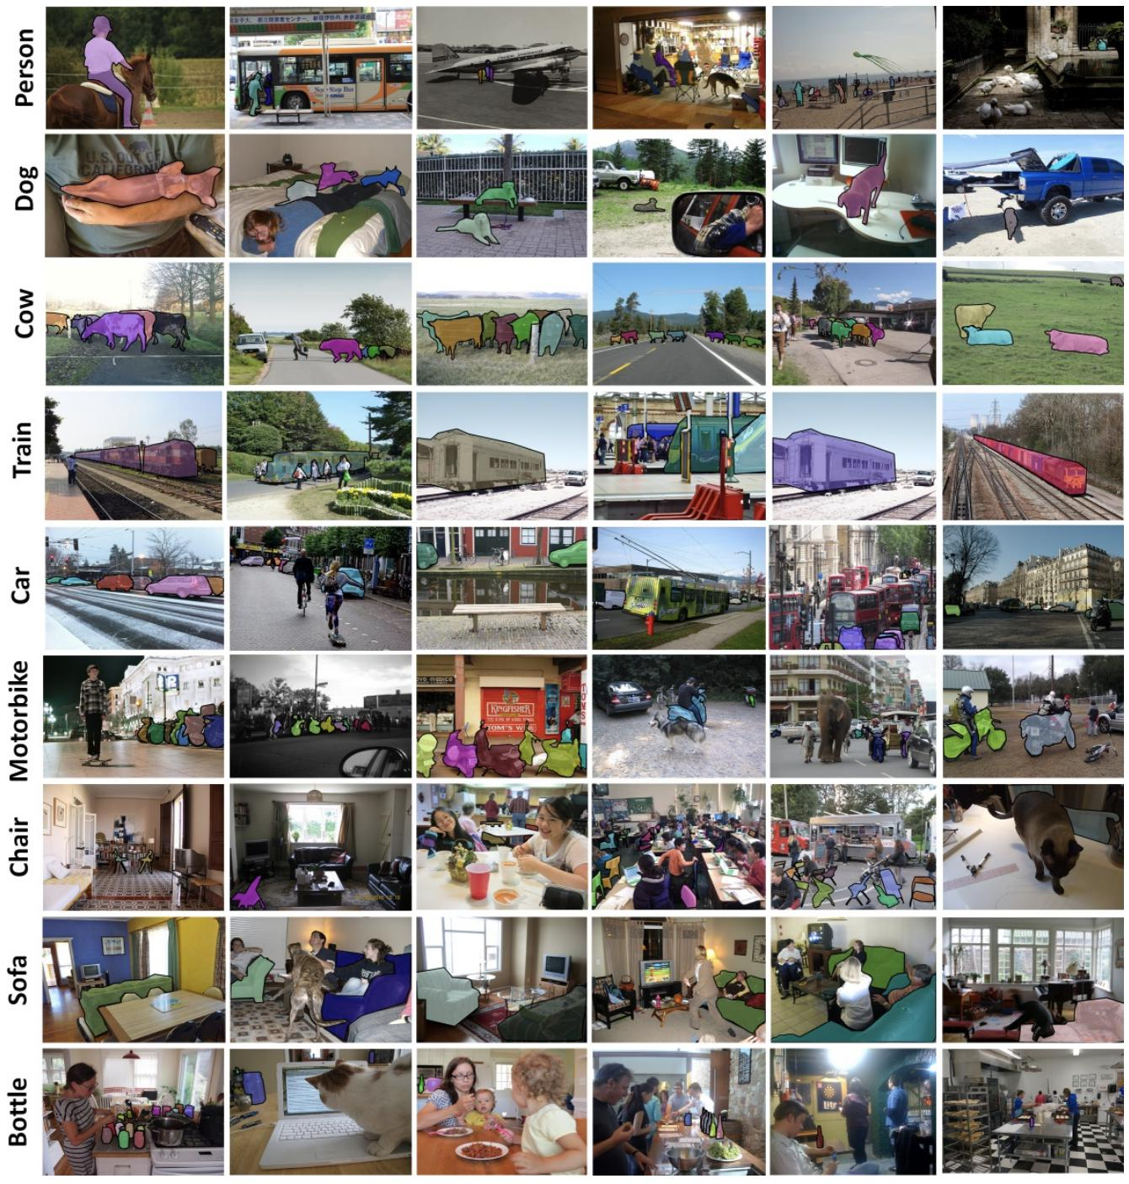
Experiment Results
Experiment Settings
Dataset
MS-COCO

Slide 32
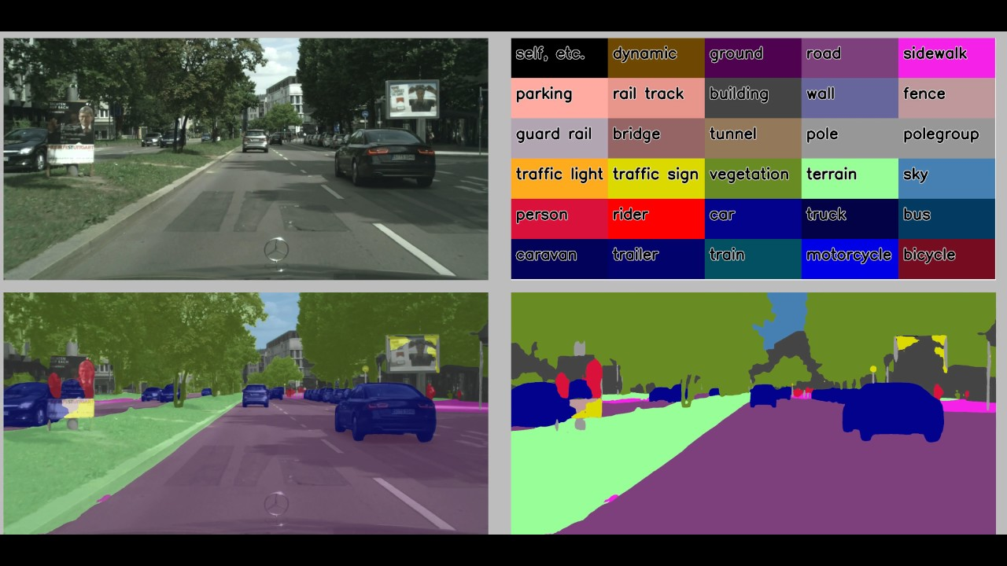
Experiment Results
Experiment Settings
Dataset
CityScape

Slide 33
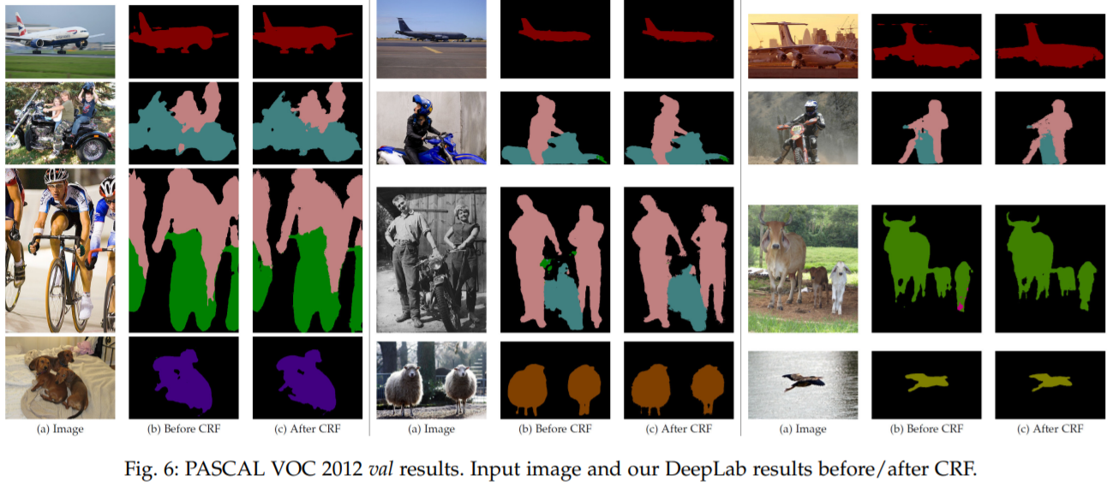
Experiment Results
PASCAL VOC 2012 Segmentation Benchmark

Slide 34
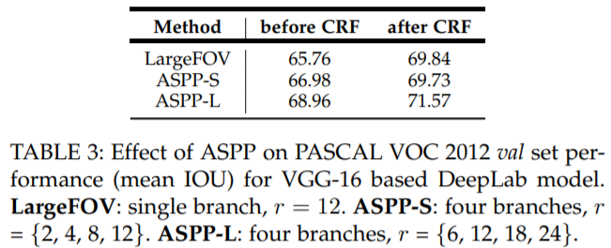
Experiment Results
PASCAL VOC 2012 Segmentation Benchmark

Slide 35
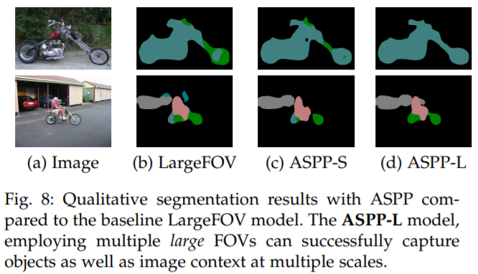
Experiment Results
PASCAL VOC 2012 Segmentation Benchmark

Slide 36
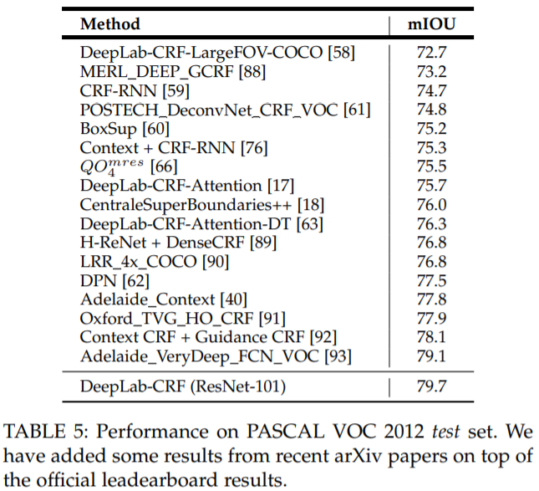
Experiment Results
PASCAL VOC 2012 Segmentation Benchmark

Slide 37
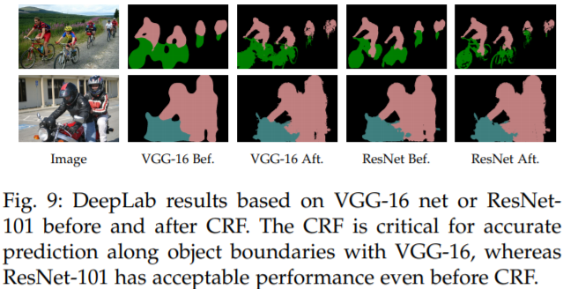
Experiment Results
PASCAL VOC 2012 Segmentation Benchmark
VGG-16 vs ResNet-101

Slide 38
Contents
Introduction
Methods
Experiment Results
Implementations

Slide 39
Implementation
Model Define
DeepLabV2
Feature Extractor
ASPP

Slide 40
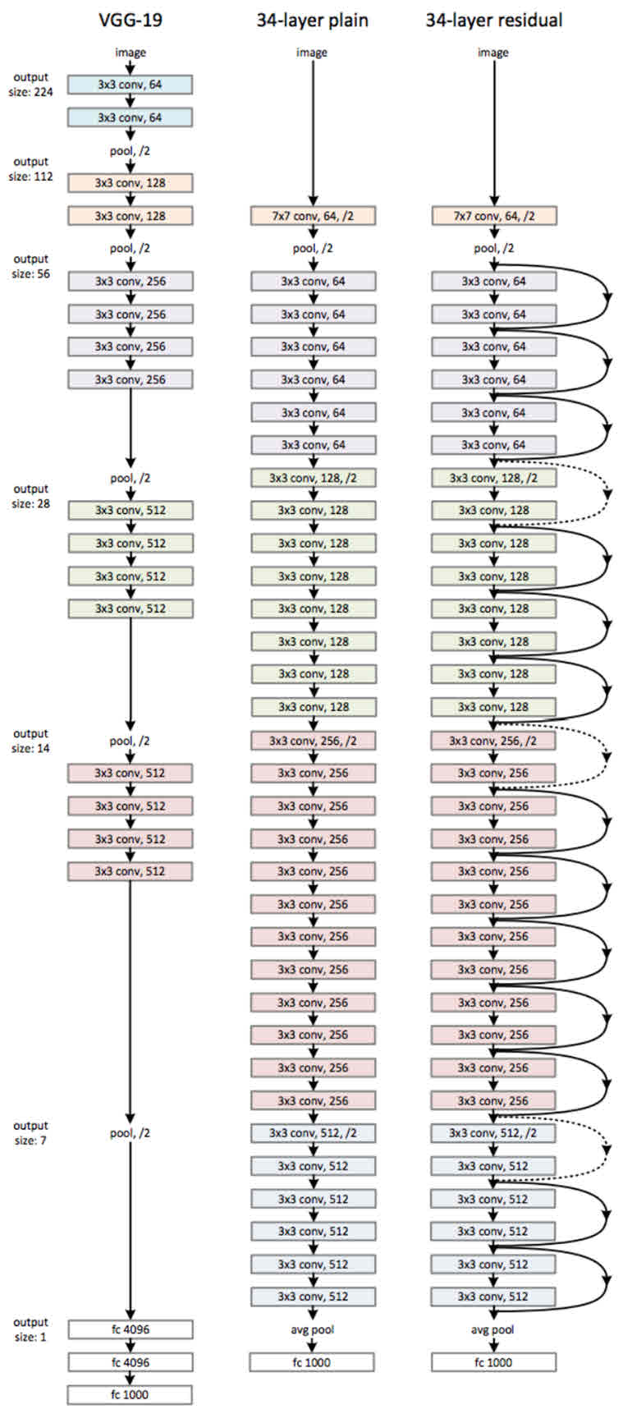
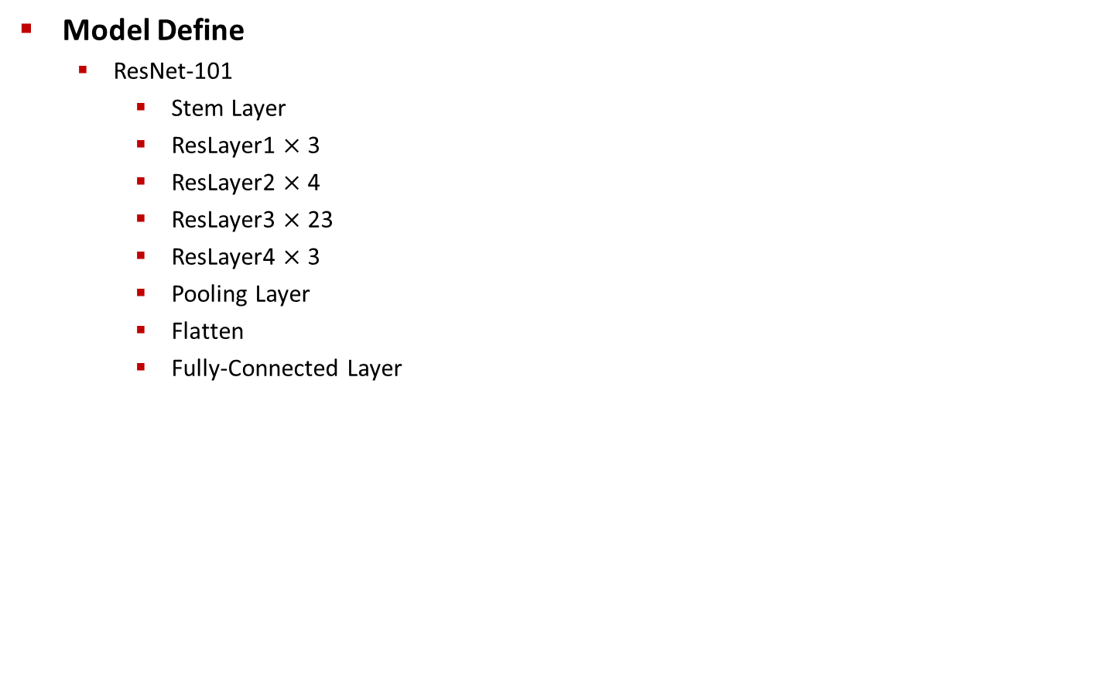
Implementation
Model Define
ResNet-101
Stem Layer
ResLayer1 $×$ 3
ResLayer2 $×$ 4
ResLayer3 $×$ 23
ResLayer4 $×$ 3
Pooling Layer
Flatten
Fully-Connected Layer

Slide 41
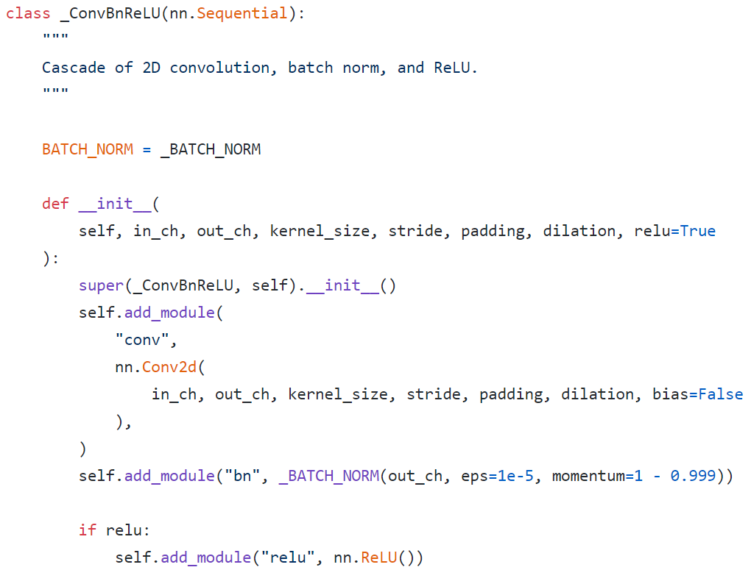
Implementation
Model Define
ResNet-101 : Base Convolution + Batch Normalization + ReLU Layer
dilation = rate

Slide 42
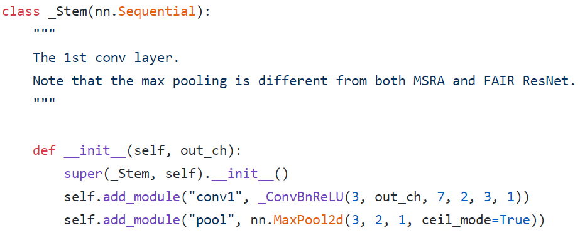
Implementation
Model Define
ResNet-101 : Stem Layer
Base Conv Layer + Max Pooling
Normal Conv

Slide 43
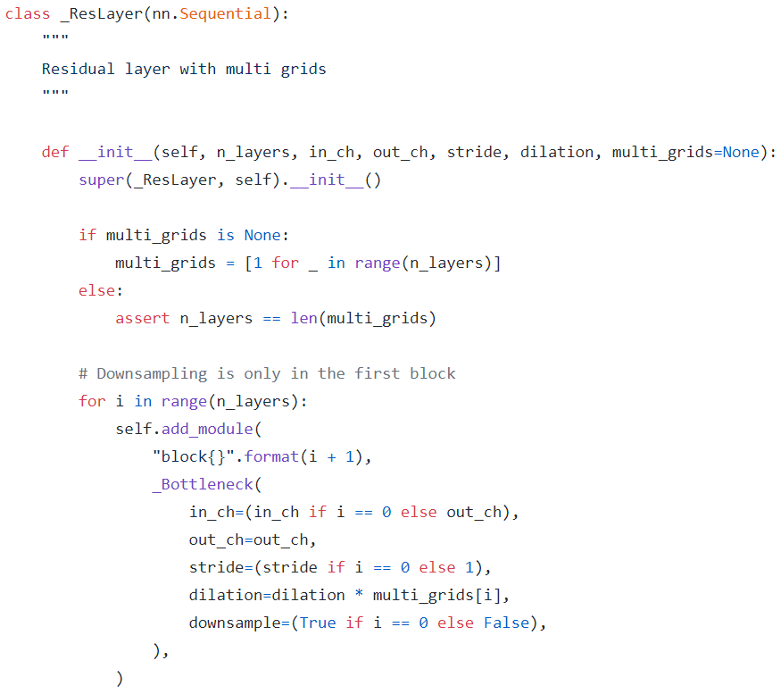
Implementation
Model Define
ResNet-101 : ResLayer

Slide 44
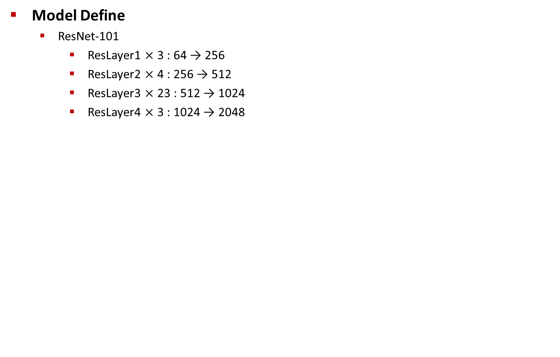
Implementation
Model Define
ResNet-101
ResLayer1 $×$ 3 : 64 → 256
ResLayer2 $×$ 4 : 256 → 512
ResLayer3 $×$ 23 : 512 → 1024
ResLayer4 $×$ 3 : 1024 → 2048

Slide 45
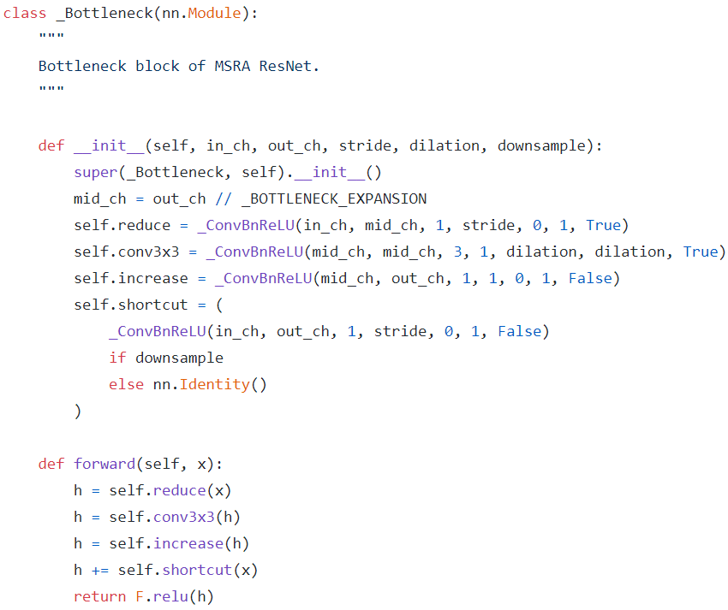
Implementation
Model Define
ResNet-101 : BottleNeck

Slide 46
Implementation
Model Define
Atrous Spatial Pyramid Pooling : input channel, output channel, rates(=dilates)
#Channel : 2048 → 21
atrous rates : 6, 12, 18, 24
Summation

Slide 47
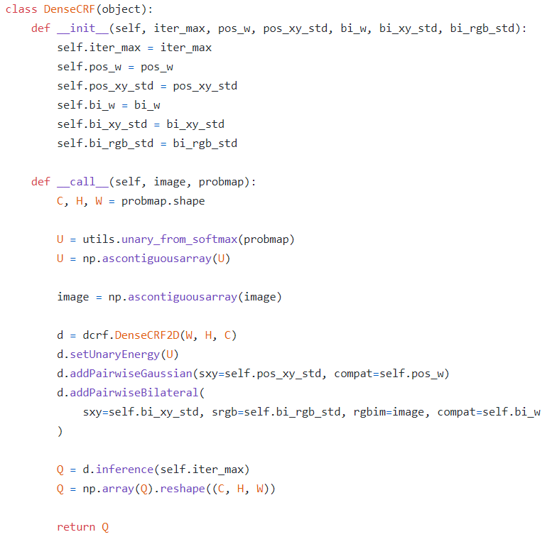
Implementation
Fully-Connected Conditional Random Field
Use python library ‘pydensecrf’

Slide 48
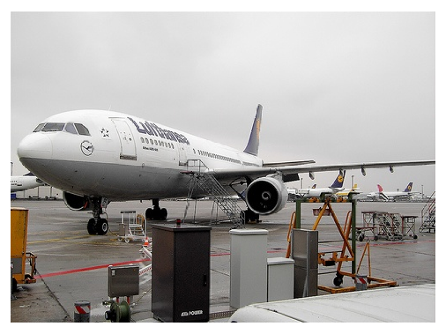


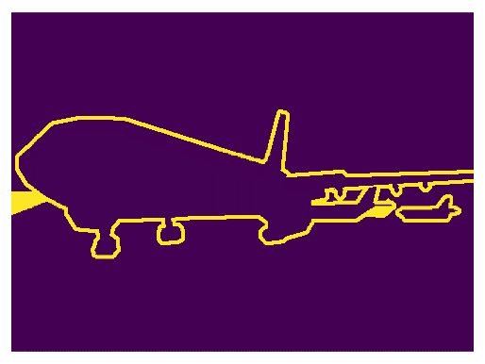
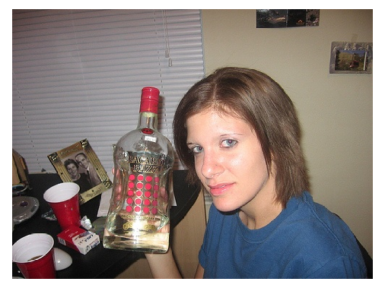



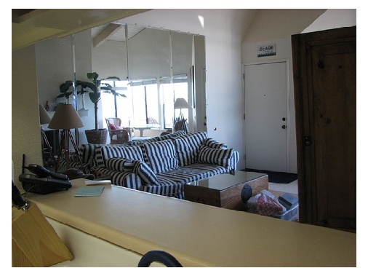



Implementation
Predict Example

